Slide 1
Year 10 – Choosing GCSE Subjects Careers Service Colleen McGaughey Careers Adviser

Slide 2
Careers Advisers are based at:
Jobs & Benefits Office
Molesworth Street
Cookstown
BT80 8NX
Tel: 0300 200 7820

Slide 4
Band 1
Compulsory Subjects: (Everyone will study the following subjects)
Accelerated Pupils | Religion | English | Ad Maths | Ad Science | ICT | PE | Careers | Form Period | LLW
Top 40 pupils | 6 | 7 | 10 | 11 | 5 | 2 | 1 | 0 | 0
Remaining pupils | 6 | 7 | 7 | 7 | 6 | 2 | 1 | 1 | 5
Choose one subject from each Option:
Option 1 (6) | Option 2 (6) | Option 3 (6)
Art and Design | Home Economics (Food Studies.) | Irish.
Moving Image Art | Heath & Social Care | French
Music | Media Studies | PE
Geography | Sports Studies | Child Development
History | Sociology | Engineering
Business Studies | Agriculture. | Drama
 |  | Business Studies

Slide 5
Band 2
Compulsory Subjects: (Everyone will study the following subjects)
Re | En | Ma | Science | PE | Ca | Fp | LLW
5 | 8 | 8 | 7 | 2 | 1 | 1 | 4
Choose one subject from each option:
Option 1 (8) | Option 2 (8) | Option 3 (8)
Travel and Tourism | Construction (OS) | Agriculture
Contemporary Craft | Certificate of Success & Wellbeing. | Engineering & Engineering Services (OS)
Drama | Sport Studies | Contemporary Cuisine (OS)
Art and Design | Total Beauty (OS) | Business Studies
ICT

Slide 6
Start by thinking about YOU!
What am I good at?
What do I enjoy?
Interests/Hobbies?
Do I like practical subjects where I
can work with my hands?
Do I enjoy sitting in a
classroom and learning?
Do you perform better in exams or coursework?

Slide 7
Before You Decide…
Find out as much as you can about GCSE subjects.
Look into new subjects carefully.
But also check content of familiar subjects –
they may not be the same at GCSE level.

Slide 8
Choosing Your Subjects
What subjects do you enjoy?
What subjects are you good at?
Take into account any requirements for careers you are interested in
e.g. Double Award science for a science career
e.g. 2ND Language needed at GCSE (Irish, French, Spanish) for university courses in the Republic of Ireland.
Consider subjects that are difficult to pick up again once dropped.

Slide 9
Who can help you decide?
Your Careers Teacher
Careers Adviser
Subject Teachers
Brothers, sisters or friends who have studied GCSE’s
Your parents/guardians

Slide 10
Key Points To Consider
I’m good at everything, all my teachers want me to pick their subject.
But what are your favourite subjects? Choose the subjects you enjoy the most.
I’m going to do History as I enjoy it.
Check course content – it could be quite different at GCSE
I’m going to do Geography – I like my teacher.
You may have a new teacher next year !

Slide 11
I’m taking French because my friend is.
Choose subjects you will like – friends can change. You might be in different classes if a lot of people choose that subject.
My sister told me to take Music - she loved it!
You may be very different- pick subjects that interest you.
I’d love to do Engineering but worry that it’s a boys subject.
There’s no such thing as boys or girls subjects.

Slide 12
But I am only Year 10…. I have no idea about what I want to be!
You don’t have to know what you want to
be right now.
Think about what kind of jobs each subject will be
useful for.
Will I get good grades by studying that subject?
Will I ENJOY it?

Slide 13
If you do not have any career ideas…
Career matching tools are available on the Careers Service website to help you make your choices, e.g. Career Ideas Quiz, Careers A-Z list & Subject Links.
Go to: www.nidirect.gov.uk/careers

Slide 14
www.nidirect.gov.uk/careers

Slide 16
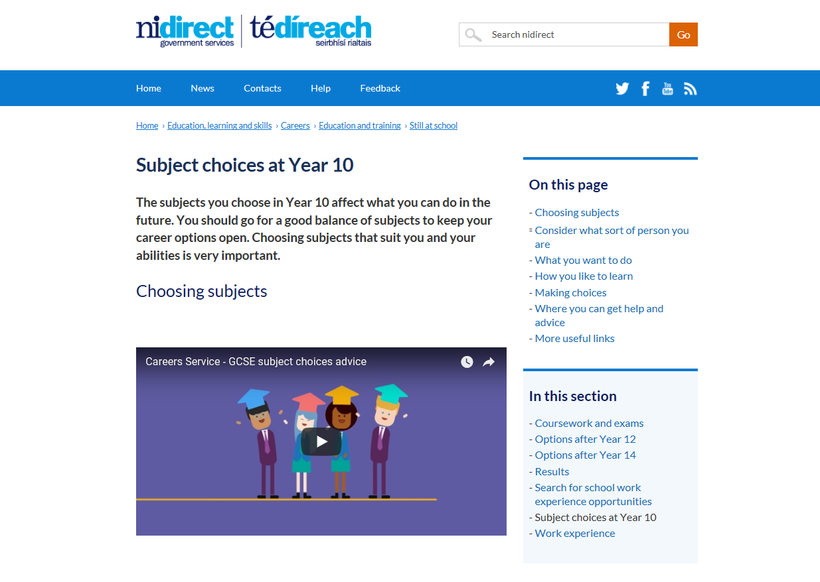
www.nidirect.gov.uk/articles/subject-choices-year-10

Slide 17
Choose subjects you enjoy
Choose subjects you are good at
Find out which subjects you need for different jobs or courses in the future
Talk to your Careers Adviser and your Teachers
Talk to your parents or guardians
Keep your options for the future open by making a balanced choice
Choose a subject because your friend is taking it
Choose or reject a subject because you like or dislike a teacher
Reject a subject because you think it’s ‘for girls’ or ‘for boys’ – there is no such thing
Choose a subject just because you think it will be easy
Choose a new subject without finding out more about it
Make a decision last minute without thinking about it

Slide 18
Any questions?

Slide 19
Contact Careers Service NI:
www.nidirect.gov.uk/careers
WebChat
Ask Careers
Tel: 0300 200 7820
Ask to speak to your local
Careers Adviser, Colleen
McGaughey
See you in Year 12!

